Slide 1
Language Modeling Toolkits
SRILM
http://www.speech.sri.com/projects/srilm/

Slide 2
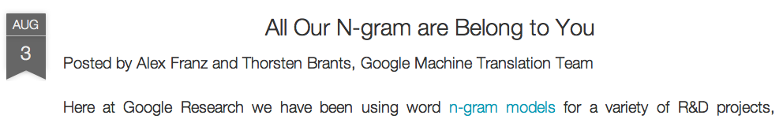
Google N-Gram Release, August 2006
…

Slide 3
Google Book N-grams
http://ngrams.googlelabs.com/
Urdu Books N-grams
http://www.cle.org.pk/clestore/cleurdungrams.htm

Slide 4
LANGUAGE MODEL EVALUATION
Which Model is Better

Slide 5
Evaluation: How good is our model?
Does our language model prefer good sentences to bad ones?
Assign higher probability to “real” or “frequently observed” sentences
Than “ungrammatical” or “rarely observed” sentences?
We train parameters of our model on a training set.
We test the model’s performance on data we haven’t seen.
A test set is an unseen dataset that is different from our training set, totally unused.
An evaluation metric tells us how well our model does on the test set.

Slide 6
Which Model is Better
Can I get a number about how good my model is for a test set?
What is the P(test_set | Model )
How we can Evaluate a Model?

Slide 7
Extrinsic evaluation of N-gram models
Best evaluation for comparing models A and B
Put each model in a task
spelling corrector, speech recognizer, MT system
Run the task, get an accuracy for A and for B
How many misspelled words corrected properly
How many words translated correctly
Compare accuracy for A and B

Slide 8
Difficulty of extrinsic (in-vivo) evaluation of N-gram models
Extrinsic evaluation
Time-consuming; can take days or weeks
So
Sometimes use intrinsic evaluation: perplexity
Perplexity is the probability of test set normalized by the number of words
Bad approximation
unless the test data looks just like the training data
So generally only useful in pilot experiments
But is helpful to think about.

Slide 9
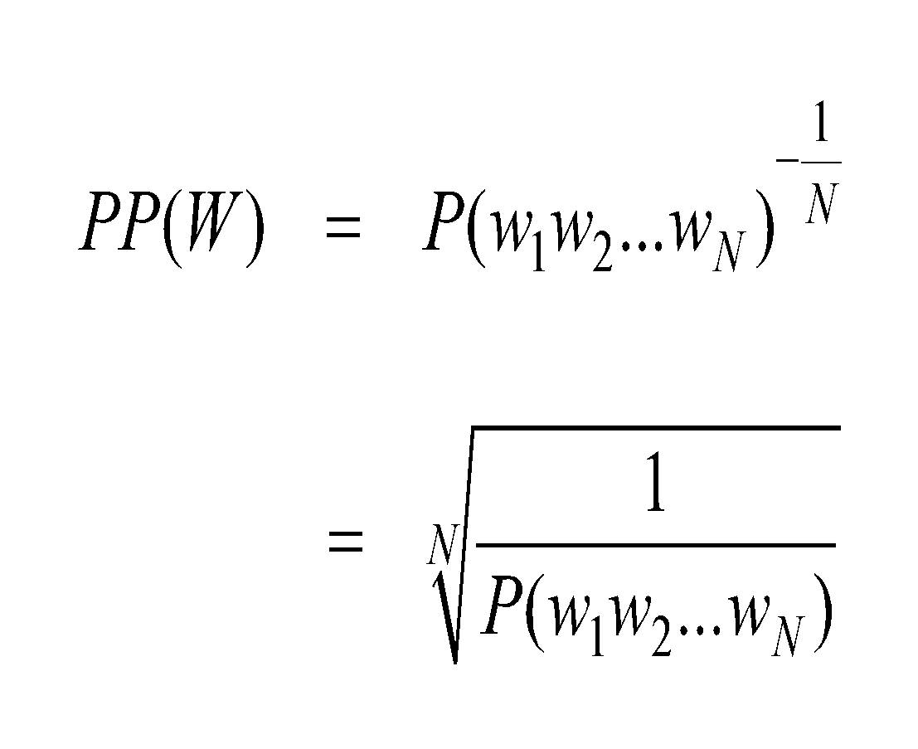
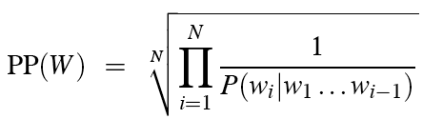
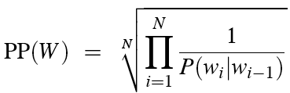
Perplexity
The best language model is one that best predicts an unseen test set
Gives the highest P(sentence)
Perplexity is the inverse probability of the test set, normalized by the number of words:
Chain rule:
For bigrams:
Minimizing perplexity is the same as maximizing probability

Slide 10
Perplexity
Different tasks have different perplexity
WSJ (109) vs Bus Information Queries (~25)
Higher the conditional probability, lower the perplexity
Perplexity is the average branching rate

Slide 11
Lower perplexity = better model
Training 38 million words, test 1.5 million words, WSJ
N-gram Order | Unigram | Bigram | Trigram
Perplexity | 962 | 170 | 109

Slide 12
The Shannon Visualization Method
Choose a random bigram
(<s>, w) according to its probability
Now choose a random bigram (w, x) according to its probability
And so on until we choose </s>
Then string the words together
<s> I
I want
want to
to eat
eat Chinese
Chinese food
food </s>
I want to eat Chinese food

Slide 13
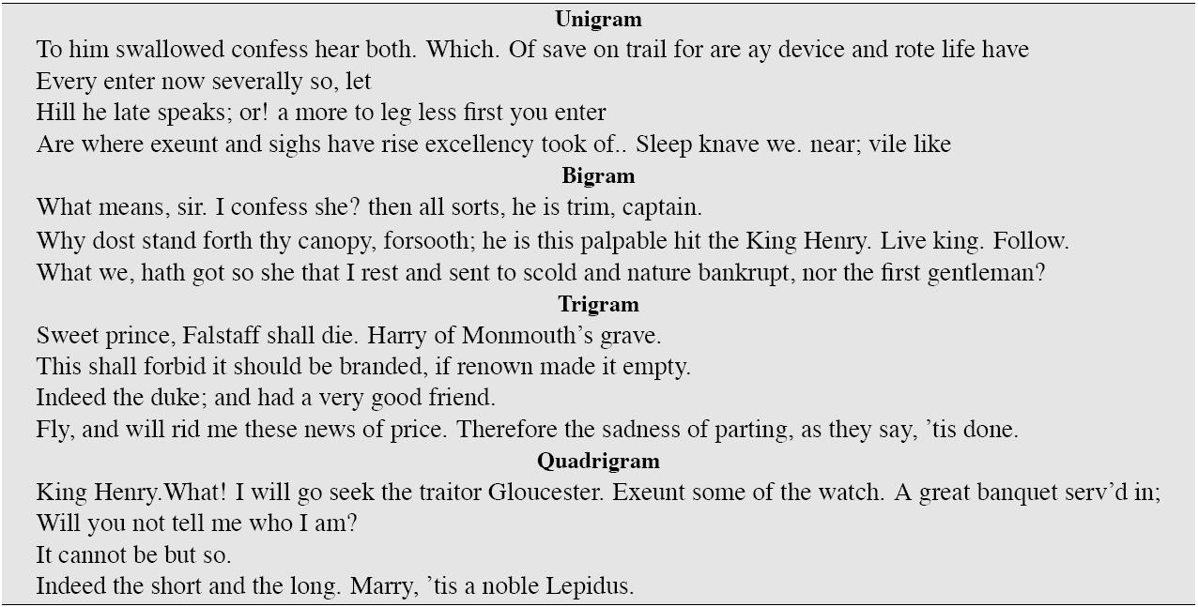
Approximating Shakespeare

Slide 14
Shakespeare as corpus
N=884,647 tokens, V=29,066
Shakespeare produced 300,000 bigram types out of V²= 844 million possible bigrams.
So 99.96% of the possible bigrams were never seen (have zero entries in the table)
Quadrigrams worse: What's coming out looks like Shakespeare because it is Shakespeare

Slide 15
The perils of overfitting
N-grams only work well for word prediction if the test corpus looks like the training corpus
In real life, it often doesn’t
We need to train robust models that generalize!
One kind of generalization: Zeros!
Things that don’t ever occur in the training set
But occur in the test set

Slide 16
Zeros
Training set:
… denied the allegations
… denied the reports
… denied the claims
… denied the request
P(“offer” | denied the) = 0
Test set
… denied the offer
… denied the loan

Slide 17
Zero probability bigrams
Bigrams with zero probability
mean that we will assign 0 probability to the test set!
And hence we cannot compute perplexity (can’t divide by 0)!

Slide 18
LANGUAGE MODELING SMOOTHING

Slide 19
Language Model Corpus
<s>JOHN READ MOBY DICK </s>
<s>MARY READ A DIFFERENT BOOK </s>
<s>SHE READ A BOOK BY CHER</s>

Slide 20
Bigram Model
<s>JOHN READ MOBY DICK </s>
<s>MARY READ A DIFFERENT BOOK </s>
<s>SHE READ A BOOK BY CHER</s>
P(JOHN READ A BOOK) =
P(JOHN|<s>) *P(READ|JOHN) *P(A|READ) *P(BOOK|A) *P(</s>|BOOK)
= C(<s> JOHN)/ c(<s>) *
C (JOHN READ) /C(JOHN ) *
C(READ A) /C(READ ) *
C (A BOOK)/C(A ) *
C(BOOK </s>) /C(BOOK )
= 1/3 *
1/1 *
2/3 *
1/2 *
1/2
≈ 0.06

Slide 21
Bigram Model
<s>JOHN READ MOBY DICK </s>
<s>MARY READ A DIFFERENT BOOK </s>
<s>SHE READ A BOOK BY CHER</s>
P(CHER READ A BOOK) =
P(CHER|<s>) *P(READ|CHER) *P(A|READ) *P(BOOK|A) *P(</s>|BOOK)
= C(<s> CHER)/ c(<s>) *
C (CHER READ) /C(CHER ) *
C(READ A) /C(READ ) *
C (A BOOK)/C(A ) *
C(BOOK </s>) /C(BOOK )
= 0/3 *
0/1 *
2/3 *
1/2 *
1/2
=0

Slide 22
Why Smoothing
If the bigram “CHER READ ” doesn’t appear in our training corpus then P(CHER| READ) = 0. But no word sequence should have 0 probability, this can’t be right.
Solution: Smoothing

Slide 23
The intuition of smoothing (from Dan Klein)
When we have sparse statistics:
Steal probability mass to generalize better
P(w | denied the)
3 allegations
2 reports
1 claims
1 request
7 total
allegations
attack
man
outcome
reports
…
claims
request
P(w | denied the)
2.5 allegations
1.5 reports
0.5 claims
0.5 request
2 other
7 total
allegations
allegations
attack
man
outcome
…
reports
claims
request

Slide 24
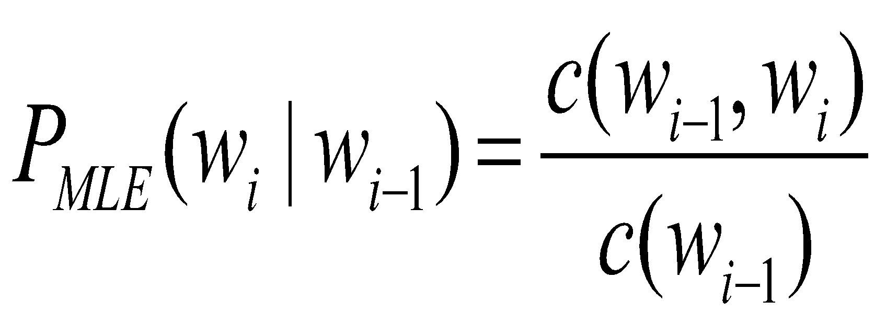
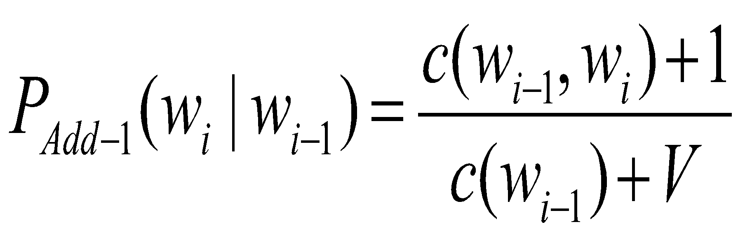
Add-one Estimation
Also called Laplace smoothing
Pretend we saw each word one more time than we did
Just add one to all the counts!
MLE estimate:
Add-1 estimate:

Slide 25
Maximum Likelihood Estimates
The maximum likelihood estimate
of some parameter of a model M from a training set T
maximizes the likelihood of the training set T given the model M
Suppose the word “bagel” occurs 400 times in a corpus of a million words
What is the probability that a random word from some other text will be “bagel”?
MLE estimate is 400/1,000,000 = .0004
This may be a bad estimate for some other corpus
But it is the estimate that makes it most likely that “bagel” will occur 400 times in a million word corpus.

Slide 26
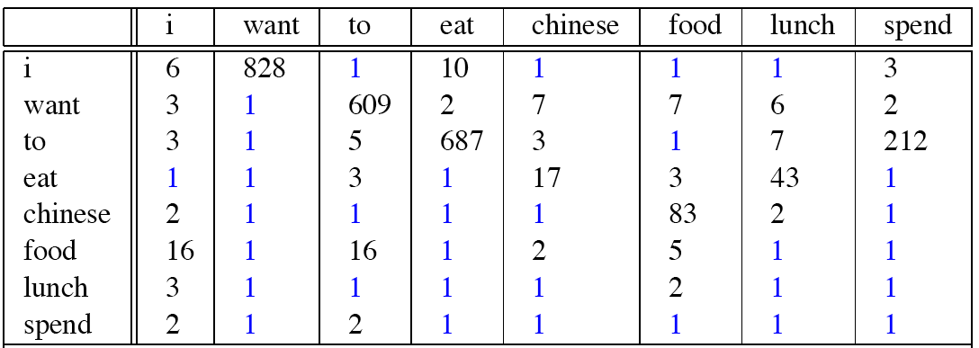
Berkeley Restaurant Corpus: Laplace smoothed bigram counts

Slide 27

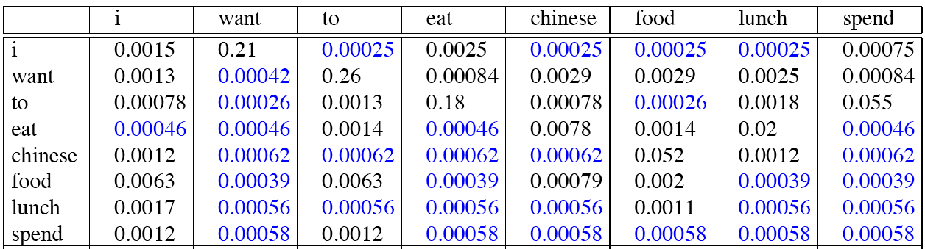
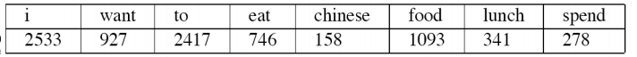
Laplace-smoothed bigrams
V=1446 in the Berkeley Restaurant Project corpus

Slide 28
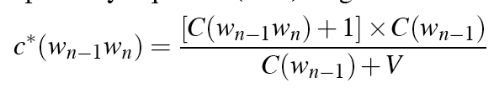
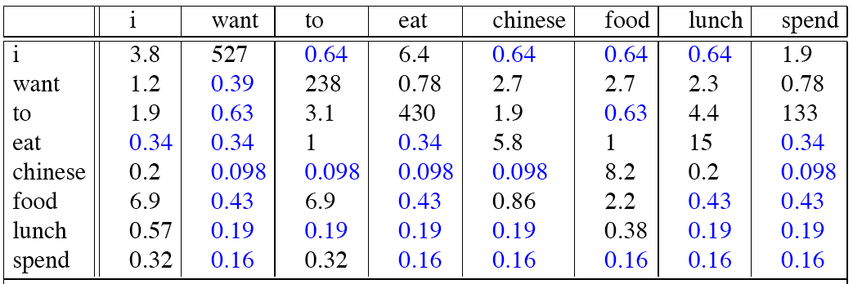
Reconstituted counts

Slide 29
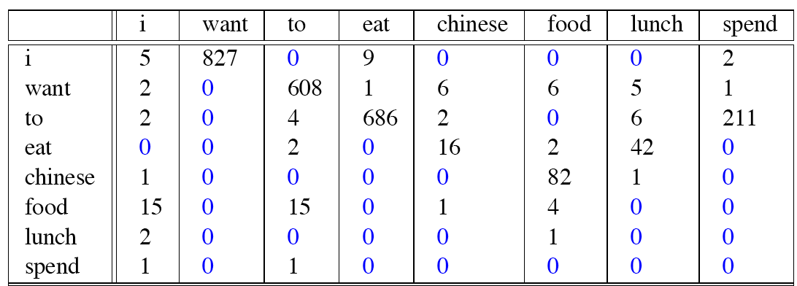
Compare with raw bigram counts
Notes:
C(want to) went from 608 to 238, P(to|want) from .66 to .26!
Discount d= c*/c
d for “chinese food” =.10!!! A 10x reduction

Slide 30
Add-1 estimation is a blunt instrument
So add-1 isn’t used for N-grams:
We’ll see better methods
But add-1 is used to smooth other NLP models
For text classification
In domains where the number of zeros isn’t so huge.

Slide 31
Backoff and Interpolation
Sometimes it helps to use less context
Condition on less context for contexts you haven’t learned much about
Backoff:
use trigram if you have good evidence,
otherwise bigram, otherwise unigram
Interpolation:
mix unigram, bigram, trigram
Interpolation works better

Slide 32
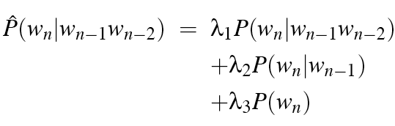

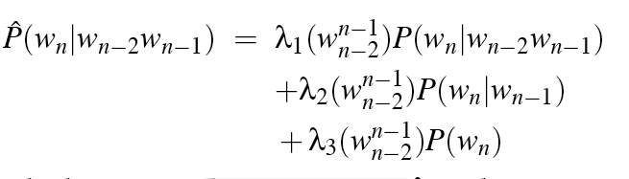
Linear Interpolation
Simple interpolation
Lambdas conditional on context:

Slide 33
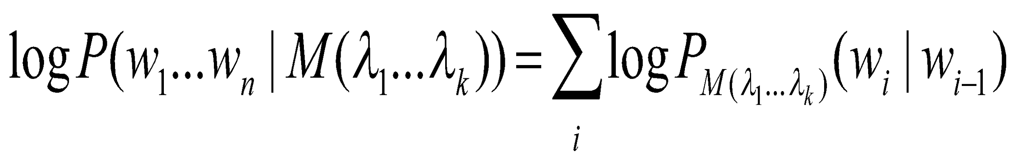
How to set the lambdas?
Use a held-out corpus
Choose λs to maximize the probability of held-out data:
Fix the N-gram probabilities (on the training data)
Then search for λs that give largest probability to held-out set:
Training Data
Held-Out Data
Test
Data

Slide 34
Unknown words: Open versus closed vocabulary tasks
If we know all the words in advanced
Vocabulary V is fixed
Closed vocabulary task
Often we don’t know this
Out Of Vocabulary = OOV words
Open vocabulary task
Instead: create an unknown word token <UNK>
Training of <UNK> probabilities
Create a fixed lexicon L of size V
At text normalization phase, any training word not in L changed to <UNK>
Now we train its probabilities like a normal word
At decoding time
If text input: Use UNK probabilities for any word not in training

Slide 35
Huge web-scale n-grams
How to deal with, e.g., Google N-gram corpus
Pruning
Only store N-grams with count > threshold.
Remove singletons of higher-order n-grams
Entropy-based pruning
Efficiency
Efficient data structures like tries
Bloom filters: approximate language models
Store words as indexes, not strings
Use Huffman coding to fit large numbers of words into two bytes
Quantize probabilities (4-8 bits instead of 8-byte float)

Slide 36
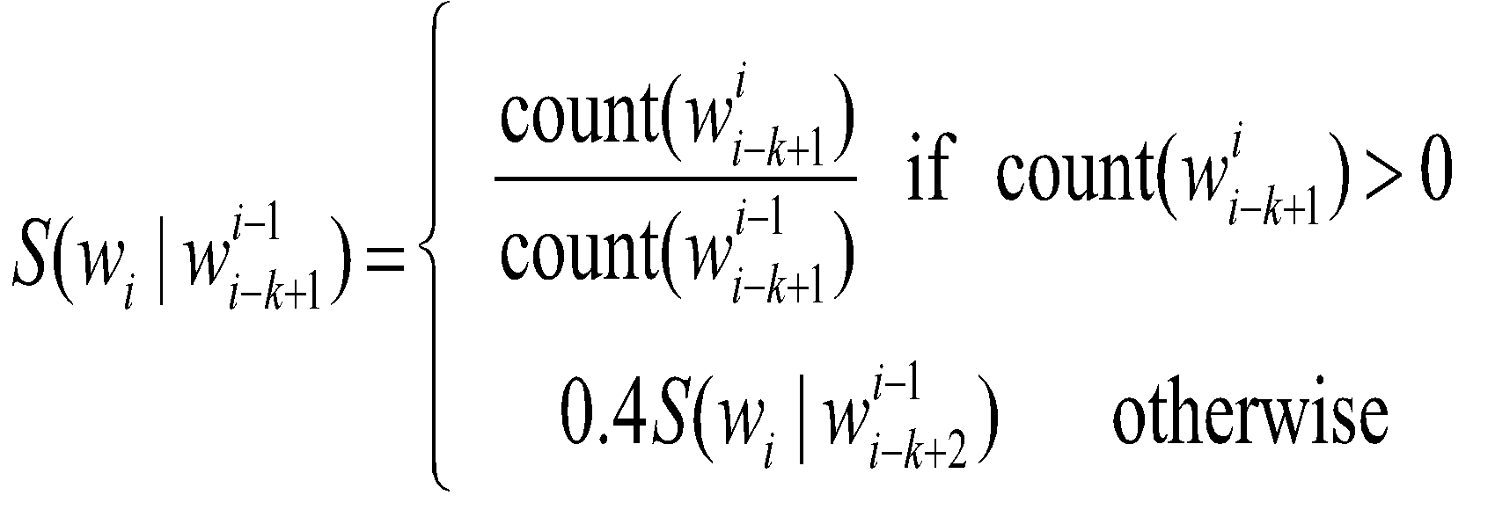
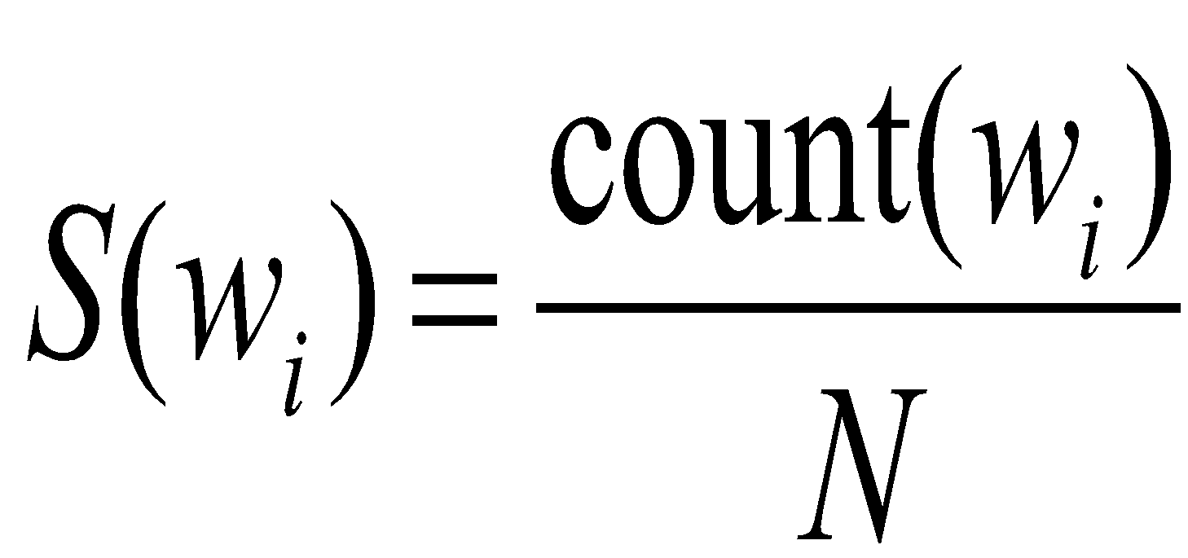
Smoothing for Web-scale N-grams
“Stupid backoff” (Brants et al. 2007)
No discounting, just use relative frequencies

Slide 37
N-gram Smoothing Summary
Add-1 smoothing:
OK for text categorization, not for language modeling
The most commonly used method:
Extended Interpolated Kneser-Ney
For very large N-grams like the Web:
Stupid backoff

